Slide 1
Best Practices for Wake Model and Optimization Algorithm Selection in Wind Farm Layout Optimization
SciTech 2018
BYU – IEA

Slide 2
Notes:
WIFM:
Placement of turbines is important due to wake
SADS

Slide 3
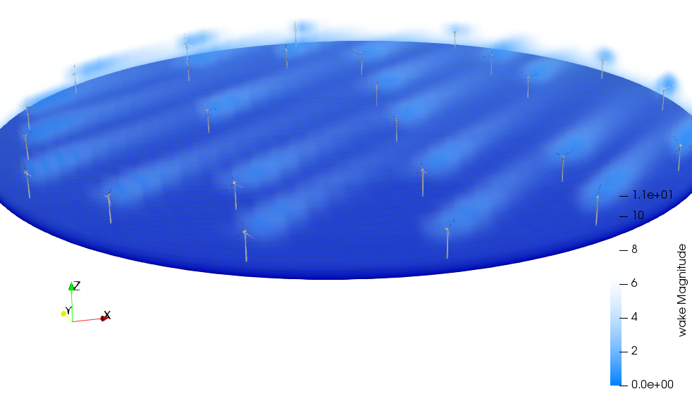
Notes:
WIFM:
Placement of turbines is important due to wake
SADS

Slide 4
Notes:
Waked rotors feel both:
1) Decrease wind velocity (so less power)
2) Increased stress (so shorter lifespan)
Maybe Jared’s graphic??

Slide 5
Notes:
Rotors in this waked area feel both:
1) Decrease wind velocity (so less power)
2) Increased stress (so shorter lifespan)
Maybe Jared’s graphic??

Slide 6
Two Variables to Isolate

Slide 7
Two Variables to Isolate
Wake Model

Slide 8
Two Variables to Isolate
Wake Model
Optimization Method

Slide 9
Wind Farm Scenario

Slide 10
Wind Farm Scenario
Turbine

Slide 11
Wind Farm Scenario
Turbine
Boundary

Slide 12
Wind Farm Scenario
Turbine
Boundary
Wind Rose

Slide 13
Wind Farm Scenario
Turbine
IEA’s 3.35 MW reference
Boundary
Wind Rose

Slide 14
Wind Farm Scenario
Turbine
IEA’s 3.35 MW reference
Cut-in at 9.8 m/s
Boundary
Wind Rose

Slide 15
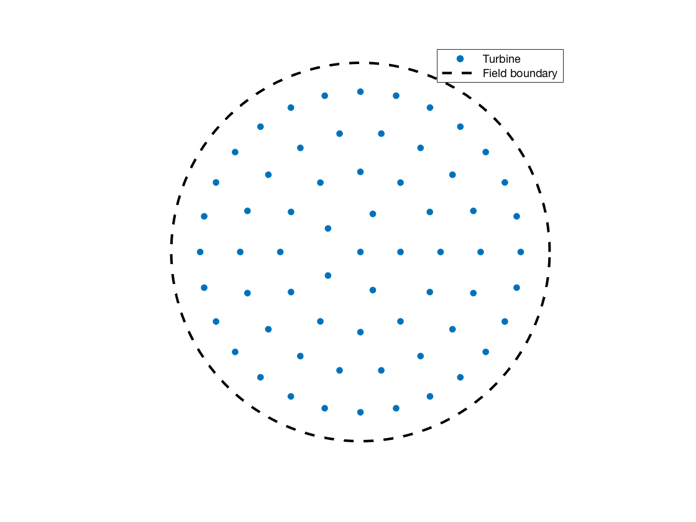
Wind Farm Scenario
Turbine
IEA’s 3.35 MW reference
Cut-in at 9.8 m/s
Boundary
Circular
Wind Rose

Slide 16
Wind Farm Scenario
Turbine
IEA’s 3.35 MW reference
Cut-in at 9.8 m/s
Boundary
Circular
Wind Rose
Bimodal

Slide 17
Wind Farm Scenario
Turbine
IEA’s 3.35 MW reference
Cut-in at 9.8 m/s
Boundary
Circular
Wind Rose
Bimodal
Off-axis

Slide 18
Case Study 1

Slide 19
Case Study 1
Optimization Only

Slide 20
Case Study 1
Optimization Only
Bastankhah’s Gaussian Wake Model

Slide 21
Case Study 1
Optimization Only
Bastankhah’s Gaussian Wake Model
.yaml input files, reader supplied

Slide 22
Case Study 1
Optimization Only
Bastankhah’s Gaussian Wake Model
.yaml input files, reader supplied
3 wind farm sizes:

Slide 23
Case Study 1
Optimization Only
Bastankhah’s Gaussian Wake Model
.yaml input files, reader supplied
3 wind farm sizes:
16
36
64
Notes:
We used perfect squares to permit grid formations
Sizes roughly double in size to test for scalability of design variables

Slide 24
Case Study 2
Notes:
Here we want to explore differences in wake models

Slide 25
Case Study 2
Combined Optimization and Wake Model
Notes:
But certain models preclude certain optimization methods,
so we had to let the participants pick both.

Slide 26
Case Study 2
Combined Optimization and Wake Model
Cross-comparison for results
Notes:
We didn’t have enough time to conduct an LES
Our analysis came from a cross-comparison of participant results through their individual models

Slide 27
Results (cs1)

Slide 28
Results (cs1)
Notes:
Trends:
#2 incresed every time
#5 decreased every time
#1 kept getting best
Everyone improved on the provided example layout

Slide 29
Results (cs1)

Slide 30
Results (cs1)

Slide 31
Results (cs1)

Slide 32
Results (cs1)
Notes:
Trend to notice here is that there is no general pattern – each had a different approach.
- sub4 was the best. Arrayed some on the outside, and then a row perpendicular to the wind rose
- sub2 used a rotational method to find superior result
- sub

Slide 33
Results (cs2)
Notes:
Interesting thing to notice here is that 1, 2, and 3 didn’t find their own placement as the best.
Means that there were optima with their model that their optimization method didn’t find – could be time, could be algorithm, could be pairing of algorithm with model.

Slide 34
Time comparison
Notes:
Of note, the top 3 submissions (#4, #2, and #10)
- All 3 used gradient-based methods
- Order of magnitudes on time are different
- Comparing 4 to 10, use of these methods is a time-tradeoff. In the 64 turbine case, sub4 found a superior result, but took about 4 times longer.
- The tradeoff in use would be time vs power – if you need a quick solution with

Slide 35
Takeaways
In these scenarios, gradient based methods were superior
Intuitive rotation steps by sub2
Sampling done by sub4
Notes:
ToDo:
1) Note that you corrected the 36 turbine case table from paper (insert #6)
2) Note that you corrected cs2’s naming in the results table for subs 4 and 5.

